Slide 1

Correlated
Concatenation
In SQL
@RileyMajor

Slide 2
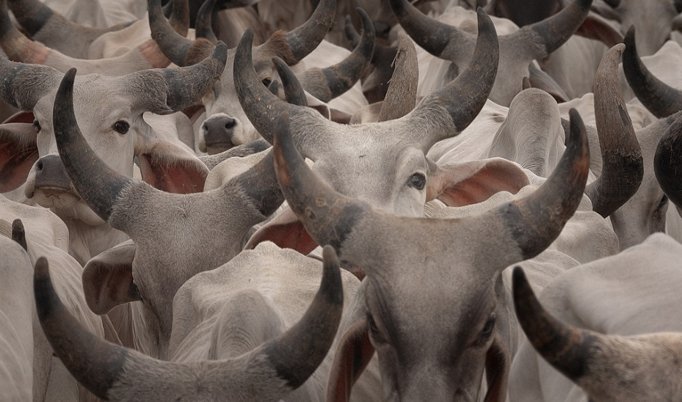
Concatenation
(Shoving stuff together.)
Animal | Trait
Cat | Cuddly
Cat | Curious
Cow | Large
Dog | Loyal
Dog | Playful
Animal | Traits
Cat | Cuddly, Curious
Cow | Large
Dog | Loyal, Playful

Slide 3

Don’t do it.
“Yeah, yeah, yeah, let's get this out of the way right from the start: Don't concatenate rows into delimited strings in SQL Server. Do it client side.”
Adam Machanic
July 12, 2006
http://sqlblog.com/blogs/adam_machanic/archive/2006/07/12/rowset-string-concatenation-which-method-is-best.aspx

Slide 4

Built-in Function? Nope.

Slide 5

Oracle Does
LISTAGG
Supports Ordering
Supports Partitioning
No DISTINCT
Version 11g Release 2 (August 2013)
SELECT Animal,
LISTAGG(Trait, ',')
WITHIN GROUP (ORDER BY Trait)
AS Traits
FROM Animals
GROUP BY Animal;

Slide 6
MySQL Does
GROUP_CONCAT
Supports Ordering
No Partitioning
Supports DISTINCT
Version 4.1 (February 2005)
SELECT Animal,
GROUP_CONCAT(DISTINCT Trait
ORDER BY Traits
SEPARATOR ', ') AS Traits
FROM Animals
GROUP BY Animal;

Slide 7
PostgreSQL Does
string_agg
No Ordering
No Windowing
No DISTINCT
Version 8.4.22 (July 2009)
SELECT Animal,
string_agg(Trait, ', ') AS Traits
FROM Animals
GROUP BY Animal;

Slide 8
Even SQLite Does

Slide 9

It’s ok…

Slide 10

Concatenation?
That’s what the + operator is for!
Nope

Slide 11

Demo
Dude, where’s my data?

Slide 12

How about a
recursive CTE?
Confusing Syntax
Deceptively Slow
Limited Depth
(without OPTION MAXRECURSION)

Slide 13

How about a cursor?
Just… No.

Slide 14

XML

Slide 15
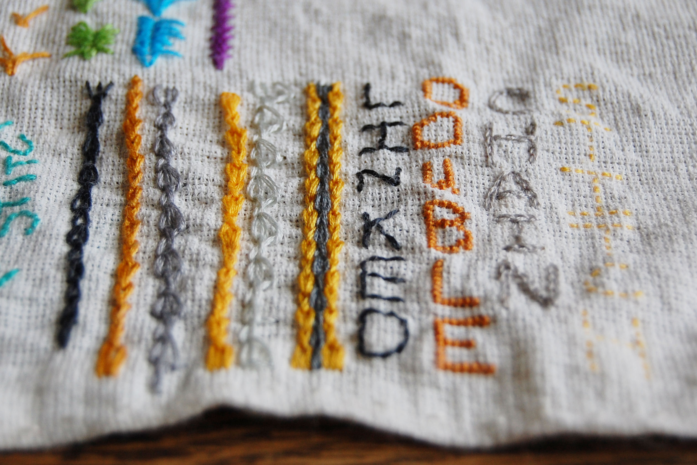
Demo
Stitching with XML

Slide 16

Key Points
No Built-In Function
But Others Have It
Don’t Use + Operator
Don’t Use Cursor or Recursive CTE
Use FOR XML with Type
Use .query to Isolate Lists

Slide 17


Riley Wheeler Major
@RileyMajor
RileyMajor.com
PASSMN@RileyMajor.com
www.linkedin.com/in/rileymajor/
Enterprise Architect
Manna Freight Systems, Inc.
http://www.MFSCorporate.com/

Slide 18
Photo Credits:
The Dark Side of the Loom
Aldo Cavini Benedetti
http://www.flickr.com/photos/aldoaldoz/5633823568/
Retrieved 2014-09-12
cows of nirona
anurag agnihotri
https://www.flickr.com/photos/agnihot/6049582522/
Retrieved 2014-09-12
Do Not Enter.
Goodiez
https://www.flickr.com/photos/thagoodiez/4354676748/
Retrieved 2014-09-12
DSC_1607 [Hammer/Screw/Board]
Justin Baeder
https://www.flickr.com/photos/justinbaeder/5317820857/
Retrieved 2014-09-12
140:365 – Left Out
charamelody
https://www.flickr.com/photos/charamelody/4757913318
Retrieved 2014-09-12
want ride bus, too
Jessica Lucia
https://www.flickr.com/photos/theloushe/3907093074
Retrieved 2014-09-12
Missing Post
Yorkd
https://www.flickr.com/photos/thedza/2518535531
Retrieved 2014-09-15
One is missing
Jules Holleboom
https://www.flickr.com/photos/holleboom/4080749814
Retrieved 2014-09-15
Keys to Nowhere
Daniel Lee
https://www.flickr.com/photos/dlee13/9022016145
Retrieved 2014-09-15
Fondue enchaînée
Alexandre Duret-Lutz
https://www.flickr.com/photos/gadl/275479322
Retrieved 2014-09-15

Slide 19
More Photo Credits:
Dominos Sackboy 101/365
Louish Pixel
https://www.flickr.com/photos/louish/5611657857
Retrieved 2014-09-15
20130730-152-of-365 (corkscrew profile)
https://www.flickr.com/photos/wilsonhui/9403633035
Retrieved 2014-09-15
TAST #32 Linked Double Chain Stitch
Audrey B.
https://www.flickr.com/photos/hetkabinet/12543174044
Retrieved 2014-09-16

Slide 20
Reference: + Operator Demo (Dude, where’s my data?)
DECLARE
@Animals TABLE (Animal varchar(50), Trait varchar(50));
INSERT INTO @Animals (Animal, Trait)
SELECT 'Cat', 'Cuddly' UNION ALL
SELECT 'Cat', 'Curious';
DECLARE
@TraitList_NoOrder varchar(max), @TraitList_Ordered varchar(max);
SELECT
@TraitList_NoOrder = '', @TraitList_Ordered = '';
SELECT
@TraitList_NoOrder = @TraitList_NoOrder + LTRIM(RTRIM(Trait)) + ', '
FROM @Animals
ORDER BY Trait;
SELECT
@TraitList_Ordered = @TraitList_Ordered + LTRIM(RTRIM(Trait)) + ', '
FROM @Animals
ORDER BY LTRIM(RTRIM(Trait));
SELECT
@TraitList_NoOrder AS 'TraitList Without ORDER BY',
@TraitList_Ordered AS 'TraitList With ORDER BY';

Slide 21
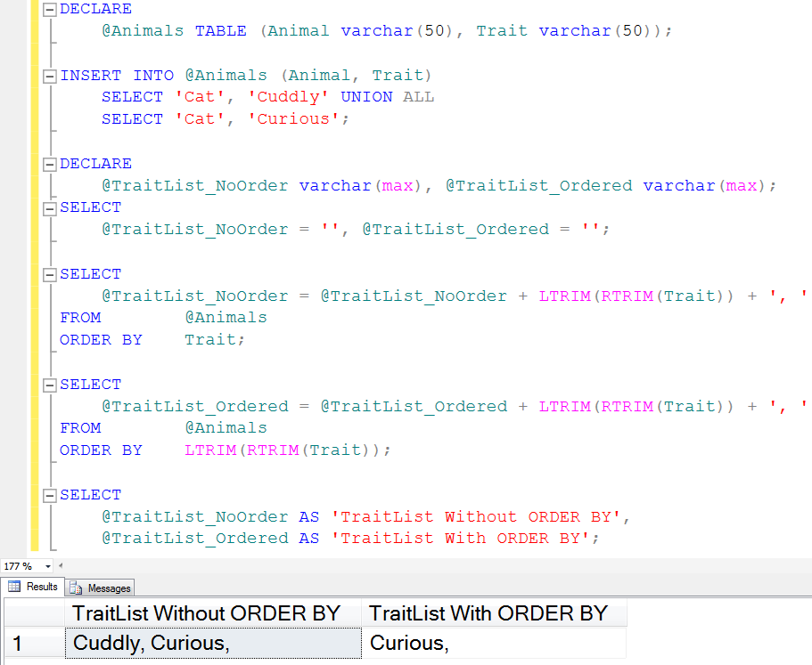
Reference: + Operator Demo (Dude, where’s my data?)
Microsoft KB 287515
http://support.microsoft.com/kb/287515

Slide 22
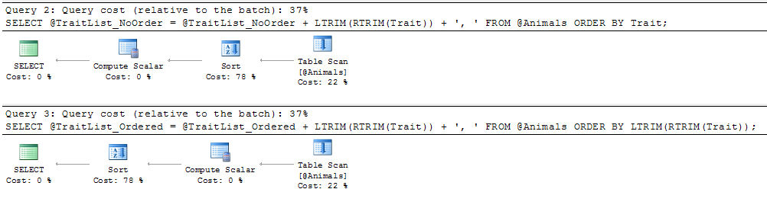
Reference: + Operator Demo (Dude, where’s my data?)

Slide 23
Reference: Recursive CTE
DECLARE
@Animals TABLE (Animal varchar(50), Trait varchar(50));
INSERT INTO @Animals (Animal, Trait)
SELECT 'Cat', 'Cuddly' UNION ALL
SELECT 'Cat', 'Curious' UNION ALL
SELECT 'Cow', 'Large' UNION ALL
SELECT 'Dog', 'Loyal' UNION ALL
SELECT 'Dog', 'Playful';
WITH Animals AS
(
SELECT
Animal,
CONVERT(varchar(max),Trait) AS Trait,
ROW_NUMBER() OVER (PARTITION BY Animal ORDER BY Trait) AS TraitNum
FROM @Animals
), RecursiveCTE AS
(
-- Anchor Query
SELECT
Animal,
Trait,
TraitNum
FROM Animals
WHERE TraitNum = 1
UNION ALL
-- Recursive Part
SELECT
Animals.Animal,
Animals.Trait + ', ' + RecursiveCTE.Trait AS TraitList,
Animals.TraitNum
FROM Animals
JOIN RecursiveCTE
ON Animals.Animal = RecursiveCTE.Animal
AND Animals.TraitNum = RecursiveCTE.TraitNum + 1
), RecursiveCTEWithMaxTraitNum AS
(
SELECT *,
MAX(TraitNum) OVER (PARTITION BY Animal) AS MaxTraitNum
FROM RecursiveCTE
)
SELECT
Animal,
Trait AS TraitList
FROM RecursiveCTEWithMaxTraitNum
WHERE TraitNum = MaxTraitNum
ORDER BY Animal;

Slide 24
Reference: Basic XML
DECLARE
@Animals TABLE (Animal varchar(50), Trait varchar(50));
INSERT INTO @Animals (Animal, Trait)
SELECT 'Cat', 'Cuddly' UNION ALL
SELECT 'Cat', 'Curious' UNION ALL
SELECT 'Cow', 'Large' UNION ALL
SELECT 'Dog', 'Loyal' UNION ALL
SELECT 'Dog', 'Playful';
WITH AnimalsDistinct AS
(
SELECT
DISTINCT Animal
FROM @Animals
)
SELECT
Animal,
(
SELECT
Trait + ', ' AS Trait
FROM @Animals a
WHERE a.Animal = AnimalsDistinct.Animal
FOR XML PATH (''), TYPE
).value('(.)[1]','varchar(max)')
FROM AnimalsDistinct;

